Slide 1



The Bureau of Refugees, Freedmen, and Abandoned Lands in Mississippi
By: Aidan Kells
Attending the University of North Georgia
Funded by the National Science Foundation

Slide 2
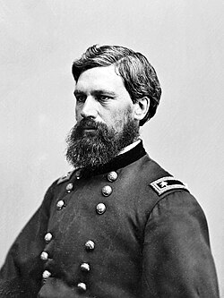
What is the Freedmen’s Bureau?
The Freedmen’s Bureau was a branch of the federal army that existed between 1863 and 1871
The Bureau supplied aid to both destitute freed people and white Southerners
Bureau’s aid towards freed people was to help them move out of slavery as free citizens
Gen. O. O. Howard by Mathew Brady. O. O. Howard was a Union General who as head of the Freedmen’s Bureau was tasked with aiding Freedmen in a post plantation society.

Slide 3
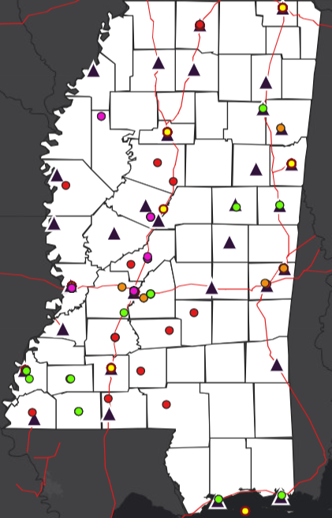
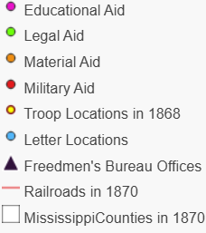
Gauging the Bureau’s Effectiveness
Used CWRGM letters tagged with “Freedmen’s Bureau” and related to freed people
Splitting the different types of aid into categories
Mapping out major rail roads, federal troop locations, and Freedmen’s Bureau offices in Mississippi

Slide 4
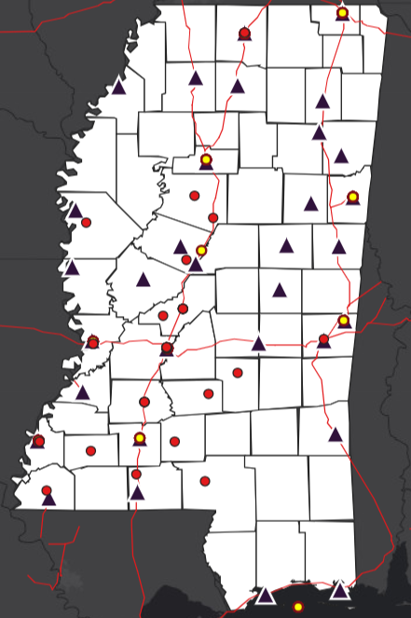
Military Protection
Situations where a dispute requires the intervention of federal troops
Letters spread all throughout Mississippi geographically
Insinuates a wider issue of violence towards freed people from white Southerners

Slide 5
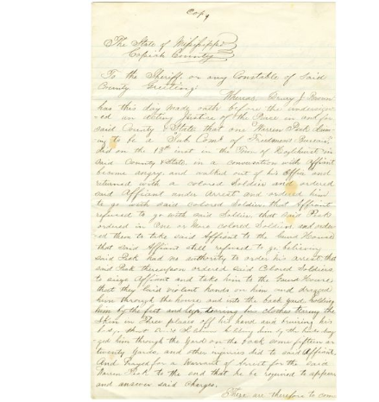
Affidavit from Thomas Jones to Mississippi Governor Benjamin G. Humphreys; October 18, 1865
A letter describing the actions of Warren Peck of the Freedmen’s Bureau in Hazlehurst MS
A white man refused to pay back loans from freed people, so Peck and federal troops arrested him
Shows the need of federal troops to enforce the Freedmen’s Bureau’s orders

Slide 6
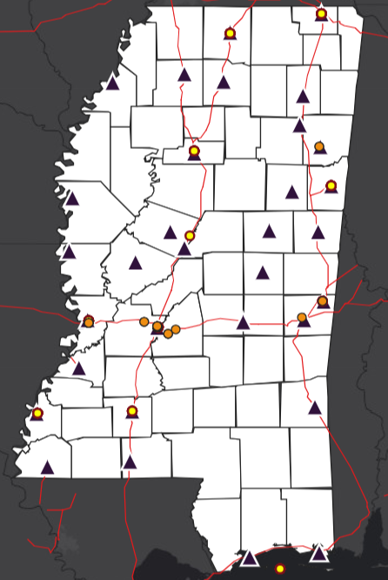
Material Aid
Consists of anything physical that the Bureau could give to freed people
Out of 93 letters 49 were about the Freedmen’s Bureau giving material aid
However, of those 49 letters, all but 5 came from outside of Jackson

Slide 7
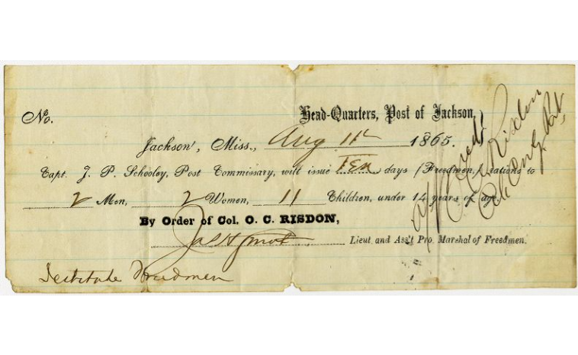
Order from Colonel O. C. Risdon to Captain J. P. Schooley; August 11, 1865
A ration order giving 14 freed people 10 days of rations food each
Shows the sheer amount of material aid the Freedmen’s Bureau gave to freed people

Slide 8
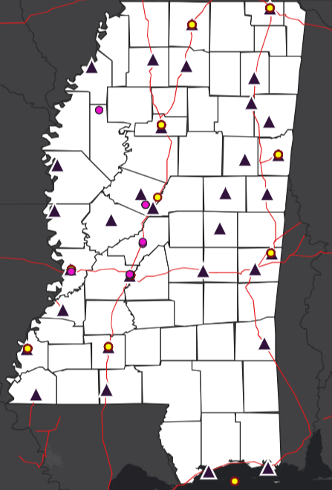
Educational Aid
Providing education to freed people was a major goal of the Freemen’s Bureau
The Map shows few letters regarding the Bureau’s aid for freed people’s education
This is because the Bureau took a more administrative roll in running the freedmen’s school

Slide 9
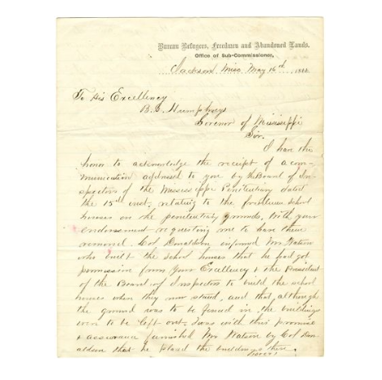
Letter from H. Gardner to Mississippi Governor Benjamin G. Humphreys; May 16, 1866
A letter from the Freedmen’s Bureau stating that a freed people’s school can’t be established in the Mississippi State Penitentiary
Shows the administrative role the Bureau played in freed people’s education

Slide 10
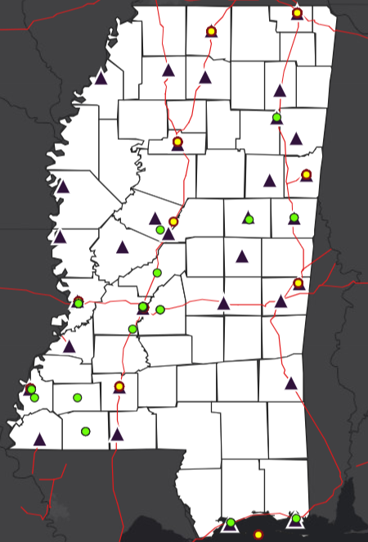
Legal Aid
Legal Aid consists of the Bureau aiding freed peoples through the existing legal system
Legal Aid covers a wide range of situations and scenarios in Reconstruction
The geographic range shows that the Bureau as highly active in advocating and protecting freed people legally

Slide 11
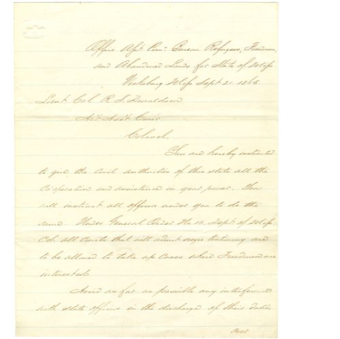
Copy of letter from Lieutenant Stuart Eldridge to Lieutenant Colonel R. S. Donaldson; September 21, 1865
A letter for the Freedmen’s Bureau stating that freed people have the right to testify in court
Shows the Bureau protecting freed people’s legal rights, and overturning discriminatory laws

Slide 12
Results
The results of my research show that the Freedmen’s Bureau was a highly effective social welfare program for the freedmen of Mississippi
However, aid was limited to the areas that had an army presence, rail access, or a Bureau office
Aid was also concentrated in areas or high populations such as the cities of Vicksburg and Jackson

Slide 13
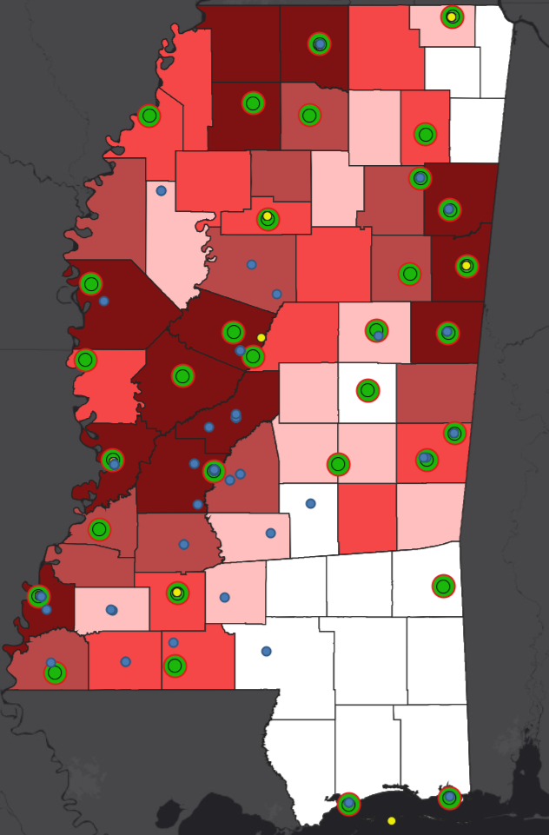
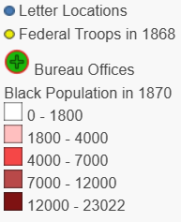
Black Population in Mississippi in 1870
All types of Freedmen’s Bureau aid Mapped onto Mississippi

Slide 14
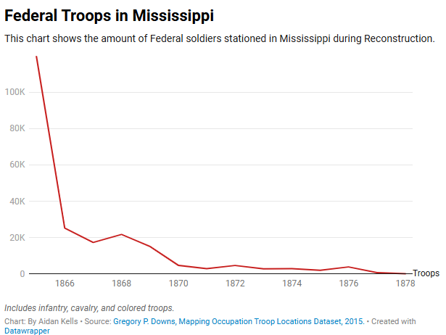
Decline of the Freedmen’s Bureau
Despite the success of the Freedmen’s Bureau, it was shut down in 1872
As the army rapidly demobilized during Reconstruction the Bureau lost its "boots on the ground”
With the absence of Federal Troops, white Southerners didn’t follow the Bureau’s orders

Slide 15
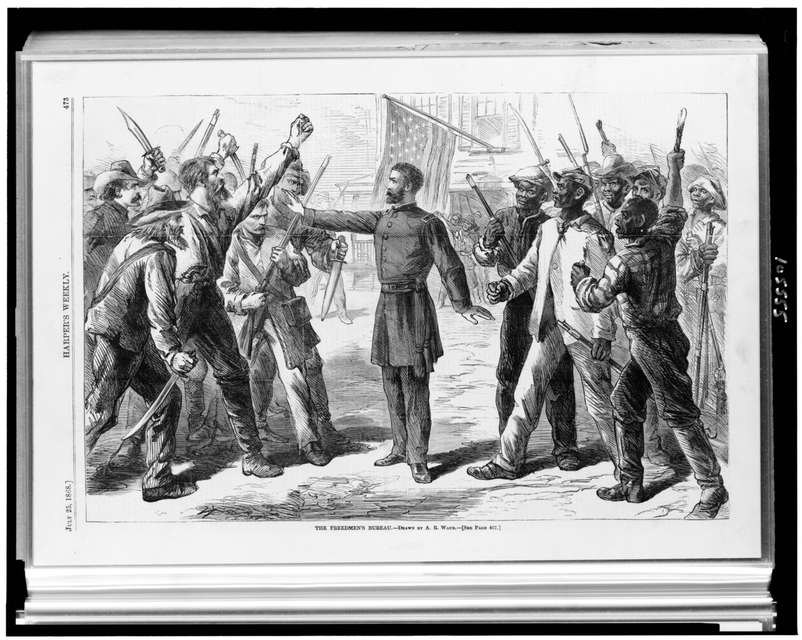
Decline of the Freedmen’s Bureau
During Congressional Reconstruction, the Freedmen’s Bureau was changed which hampered its effectiveness
The Bureau’s mission changed from giving social welfare to protecting freedmen’s rights
The Bureau switched from an organization staffed by the army to being staffed by civilians
The Freedmen’s Bureau by A.R. Waud. This depiction of the Bureau shows the tenuous position the Bureau had to navigate in the reconstruction South: aiding freed slaves while dealing with white southern aggression towards them.

Slide 16
Conclusion
The Freedmen’s Bureau was an effective social welfare agency in Mississippi, giving critical aid and resources to the freed people of Mississippi
However, the Bureau became less effective because of the demobilizing army, massive resistance from white Southerners, the “civilianization” of the Bureau, and the shifting mission of the Bureau which lacked the manpower and functionality to achieve

Slide 17
Sources
Thomas, Col Samuel, Gen Thomas J Wood, Gen Alvan C Gillem, and Gen Adelbert Ames. “MISSISSIPPI HEADQUARTERS Assistant Commissioner” (n.d.).
Marjorie H. Parker, “Some Educational Activities of the Freedmen’s Bureau,” The Journal of Negro Education 23, no. 1 (1954): 9–21.
Robert C. Lieberman, “The Freedmen’s Bureau and the Politics of Institutional Structure,” Social Science History 18, no. 3 (1994): 405–437.
Ira C. Colby, “The Freedmen’s Bureau: From Social Welfare to Segregation,” Phylon (1960-) 46, no. 3 (1985): 219–230.
Richard Fleischman, Thomas Tyson, and David Oldroyd, “THE U.S. FREEDMEN’S BUREAU IN POST-CIVIL WAR RECONSTRUCTION.,” Accounting Historians Journal 41, no. 2 (December 1, 2014): 75–109.
The Civil War and Reconstruction Governors of Mississippi Project.
Gregory P. Downs, Mapping Occupation Troop Locations Dataset, 2015.
https://railroads.unl.edu/resources/

